Slide 1

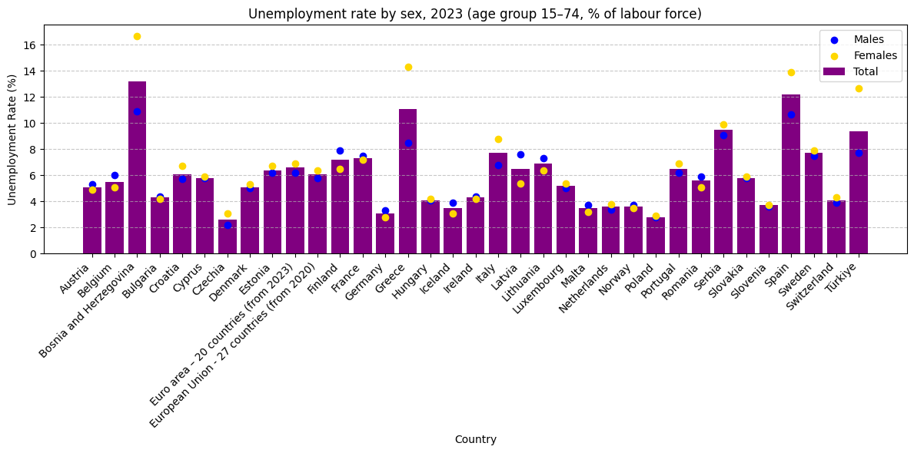
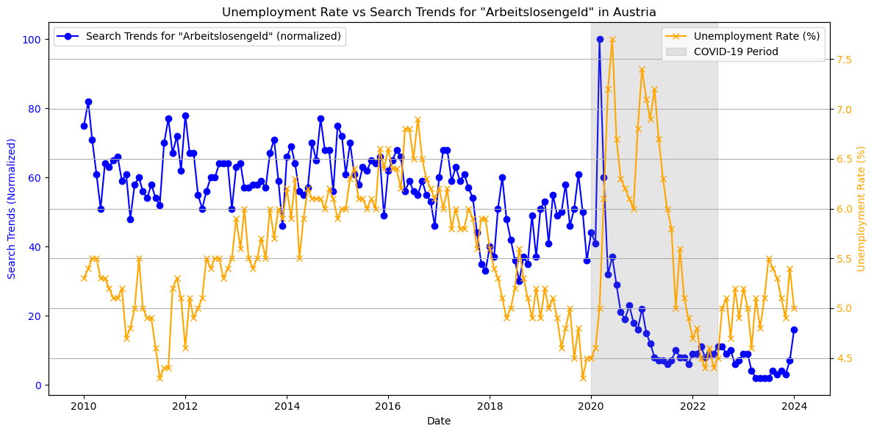
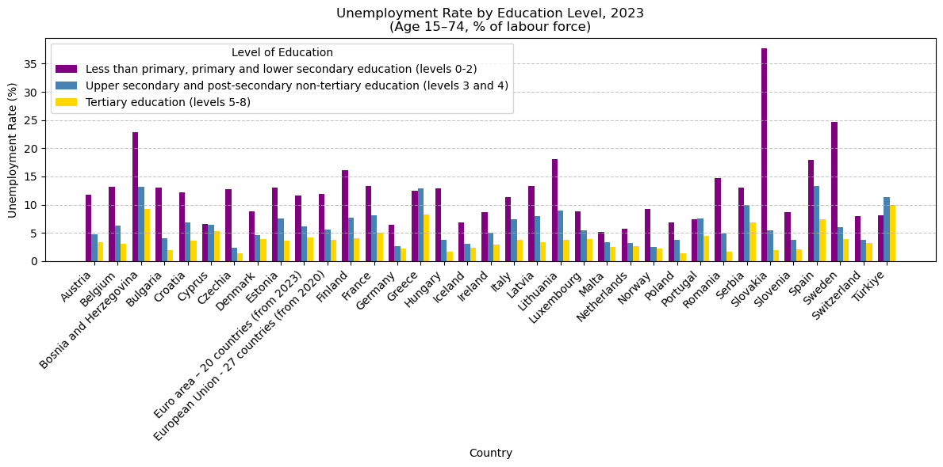
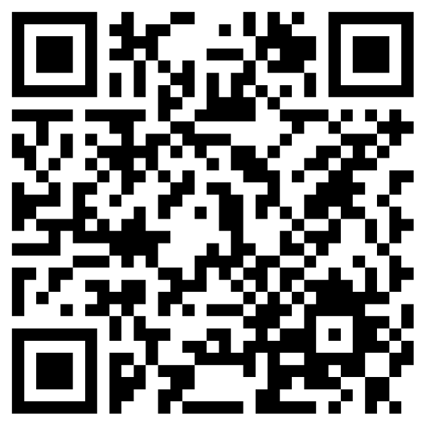
Research Poster – Group 9
Bojan Bozunovic, Florian Habersatter, Raffael Alexander Kern, Sebastian Wolf
Economic and Social Drivers of Unemployment and Their Impact on Google Search Trends in Austria
“How do social and economic factors such as GDP, social spending, and education influence unemployment rates across countries, and to what extent do unemployment rates impact Google search trends and user behavior in Austria?”
Economic Insights:
Understand impact of GDP, social spending, education on unemployment rates in Europe
Valuable for policymakers and economists
Behavioral Patterns:
Analyze influence of unemployment rates on Google search trends in Austria
Reveal public sentiment and information-seeking behavior during economic changes
Title
Research Question & Motivation
Eurostat:
Provides detailed statistics on unemployment rates, segmented by age, gender, and education levels.
OECD:
Offers comprehensive insights into unemployment rates and analyzes government spending on social programs aimed at labor market integration.
World Bank:
Supplies historical GDP data for various countries, allowing for an assessment of economic trends and their impact on employment levels.
Google Trends Data:
Tracks search interest for the term "Arbeitslosengeld," providing insights into public awareness and concerns about unemployment benefits over time in Austria
Methods
Data
Descriptive Statistics
Summarized unemployment rates and related factors across countries and demographics.
Correlation Analysis
Examined relationships between key variables such as education levels, GDP, unemployment rates, and search trends.
Cross-Correlation Analysis
Identified time-lagged relationships between unemployment rates and search trends (e.g., “Arbeitslosengeld”).
Investigated seasonal patterns in unemployment rates and search trends to identify periodic behaviors
Comparative Analysis
Regional variations (e.g., Europe vs. other continents) to uncover geographic trends
Cross-correlation starts low but increases with time lag
Indicates a lagged relationship between variables
Unemployment rate leads to increased search trends after a delay
Graph in Repository
Results 1
Results 2
Significant gender disparities in countries like Greece and Bosnia and Herzegovina
Correlation between umemployment rate and eduction level: -0.63
Conclusion
Link to our Github Repository:
Gender disparities in unemployment rates are evident in specific countries
Unemployment levels and GDP show a correlation of 0.6
Education levels strongly influence unemployment, with higher education linked to lower rates
Unemployment payments are closely tied to unemployment levels (also among countries with similar GDP)
No clear link exists between inflation and unemployment across countries
In Austria, search trends for "Arbeitslosengeld" somewhat align with unemployment levels
Seasonal patterns detected in search trends related to unemployment
LV - 706025 Foundations of Computational Social Systems WS 2024/25

